Slide 1


Comparing Tourism in Economic Hubs
2003-2013
Timothy Yip

Slide 2
Outline
Definition of Tourism
Overall Tourism by the number
Top 5 Tourism countries
Looking at Tourism number at 6 Different countries
Opportunities and Next Step

Slide 3
Definitions
Inbound Tourism is the act of someone travelling to a country other than that of where they live for the purpose of tourism.
Outbound Tourism is the act of travelling ‘out’ of your home country for the purposes of tourism.

Slide 4
Tourism by the Numbers
Year | # of Tourist
2003 | 717,890,425
2004 | 791,610,927
2005 | 837,159,574
2006 | 881,331,251
2007 | 944,182,510
2008 | 959,829,298
2009 | 919,034,551
2010 | 979,887,488
2011 | 1,025,303,086
2012 | 1,071,612,064
2013 | 1,123,200,395

Slide 5
Where are people going? (Country)
?

Slide 6
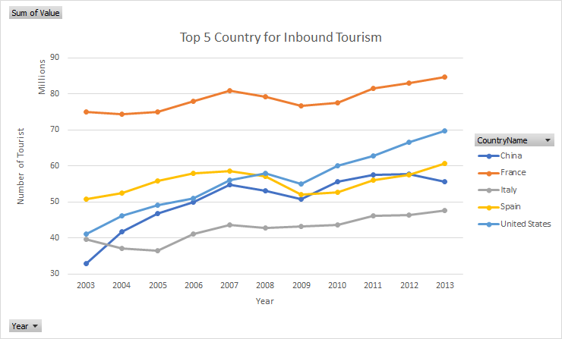
Top 5 Country for Tourism
Overall : France
* The data on inbound tourists refer to the number of arrivals, not to the number of people traveling. Thus a person who makes several trips to a country during a given period is counted each time as a new arrival.

Slide 7






Looking at Tourism Numbers (2003-2013)
France
Singapore
Hong Kong
Spain
United Kingdom
United States

Slide 8
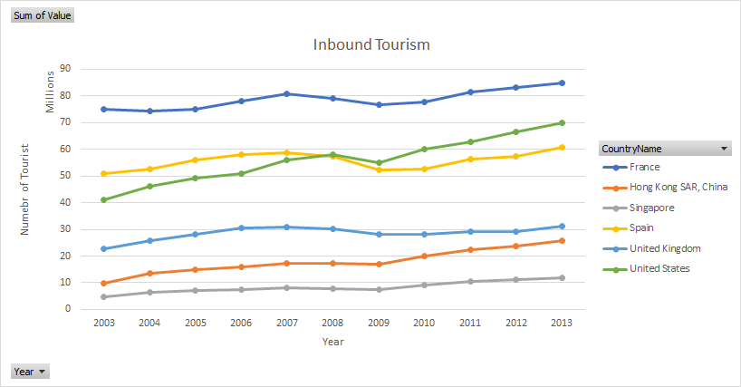
Inbound Tourism by Numbers ¹

Slide 9
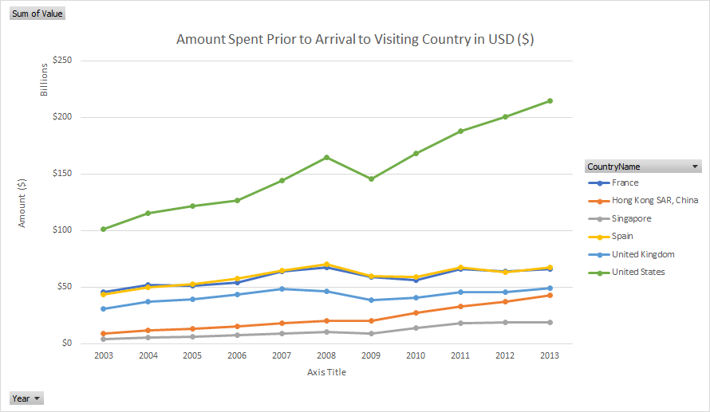
Amount Paid Prior Arrival to Visiting Country ²

Slide 10
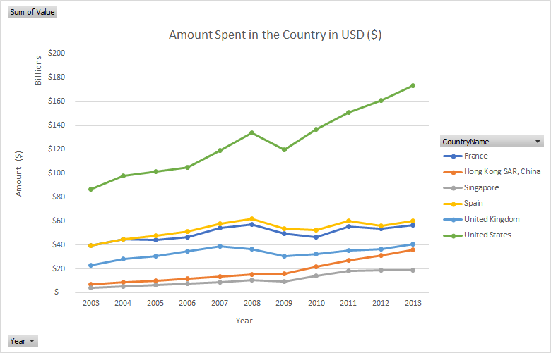
Amount Spent in the Visiting Country ³

Slide 11
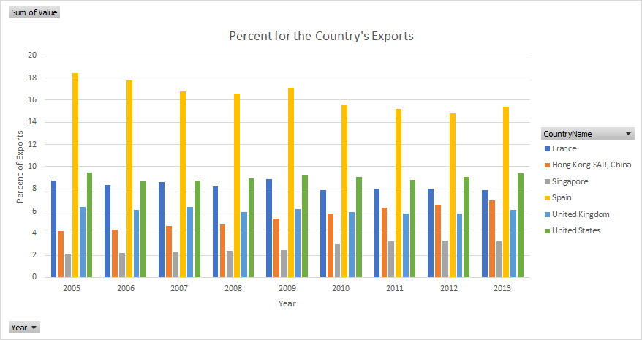
Percent Tourism of the Country Exports ⁴

Slide 12
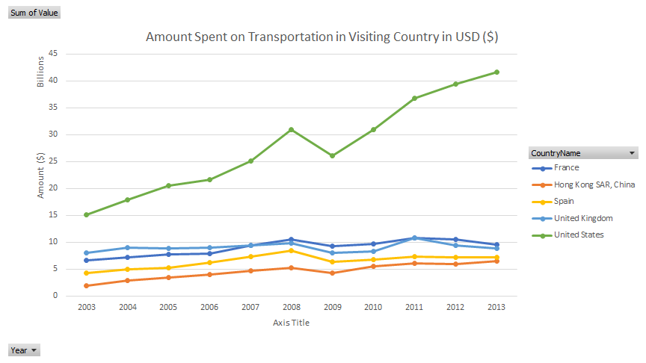
Amount Spent on Transportation with in the Country ⁵

Slide 13

Opportunities and Next Steps
Tracking tourism data at a micro level
Tracking business and leisure travels
Tracking/Creating micro spending for
Categories for Goods and Services
Transportation
Tracking Domestic Tourism
Track spending in each major tourist regions/cities
Hong Kong Skyline

Slide 14

Opportunities and Next Steps
Looking at each country exports and compare it to their other export industries
Why doesn’t Singapore have Transportation spending data?
Looking at why is it more expensive traveling to and in the United States
Looking at updated dataset to see how countries recover after the Covid-19 Pandemic
London Skyline

Slide 15
Footnotes
1. International tourism, number of arrivals
International inbound tourists (overnight visitors) are the number of tourists who travel to a country other than that in which they have their usual residence, but outside their usual environment, for a period not exceeding 12 months and whose main purpose in visiting is other than an activity remunerated from within the country visited. When data on number of tourists are not available, the number of visitors, which includes tourists, same-day visitors, cruise passengers, and crew members, is shown instead. Sources and collection methods for arrivals differ across countries. In some cases data are from border statistics (police, immigration, and the like) and supplemented by border surveys. In other cases data are from tourism accommodation establishments. For some countries number of arrivals is limited to arrivals by air and for others to arrivals staying in hotels. Some countries include arrivals of nationals residing abroad while others do not. Caution should thus be used in comparing arrivals across countries. The data on inbound tourists refer to the number of arrivals, not to the number of people traveling. Thus a person who makes several trips to a country during a given period is counted each time as a new arrival.\
2. International tourism, receipts (current US$)
International tourism receipts are expenditures by international inbound visitors, including payments to national carriers for international transport. These receipts include any other prepayment made for goods or services received in the destination country. They also may include receipts from same-day visitors, except when these are important enough to justify separate classification. For some countries they do not include receipts for passenger transport items. Data are in current U.S. dollars.

Slide 16
Footnotes
3. International tourism, receipts for travel items (current US$)
International tourism receipts for travel items are expenditures by international inbound visitors in the reporting economy. The goods and services are purchased by, or on behalf of, the traveler or provided, without a quid pro quo, for the traveler to use or give away. These receipts should include any other prepayment made for goods or services received in the destination country. They also may include receipts from same-day visitors, except in cases where these are so important as to justify a separate classification. Excluded is the international carriage of travelers, which is covered in passenger travel items. Data are in current U.S. dollars.
4. International tourism, receipts (% of total exports)
International tourism receipts are expenditures by international inbound visitors, including payments to national carriers for international transport. These receipts include any other prepayment made for goods or services received in the destination country. They also may include receipts from same-day visitors, except when these are important enough to justify separate classification. For some countries they do not include receipts for passenger transport items. Their share in exports is calculated as a ratio to exports of goods and services, which comprise all transactions between residents of a country and the rest of the world involving a change of ownership from residents to nonresidents of general merchandise, goods sent for processing and repairs, nonmonetary gold, and services.
5. International tourism, receipts for passenger transport items (current US$)
International tourism receipts for passenger transport items are expenditures by international inbound visitors for all services provided in the international transportation by resident carriers. Also included are passenger services performed within an economy by nonresident carriers. Excluded are passenger services provided to nonresidents by resident carriers within the resident economies; these are included in travel items. In addition to the services covered by passenger fares--including fares that are a part of package tours but excluding cruise fares, which are included in travel--passenger services include such items as charges for excess baggage, vehicles, or other personal accompanying effects and expenditures for food, drink, or other items for which passengers make expenditures while on board carriers. Data are in current U.S. dollars.

Slide 17
Sources:
Kaggle
United Nations World Tourism Organization (UNWTO)
UNWTO DashBoards
France Tourism
Hong Kong Tourism
Spain Tourism
Singapore Tourism
United Kingdom Tourism
United States Tourism

